Slide 1
Json is Every where
XML are replaced by JSON
No SQL Databases
Message broker Kafka etc. are JSON
Microservices API talks in JSON
UI/UX is JSON driven
You may need to transform one JSON structure to Other JSON structure

Slide 2
We have one not so good Solution.
Convert Json to XML
Use XSLT to transform XML→XML
Convert XML to Json
JSON → XML → XSLT → XML → JSON
This is not efficient
Not maintainable
Too complex system for simple task

Slide 3
Jolt
Introducing
JsOn Language for Transform
To Transform one JSON structure to another

Slide 4
JOLT is Better Solution.
Using JOLT Directly JSON → JSON transformation
90% of transformation is achievable using JOLT
10% through traverser

Slide 5
How to use JOLT?
Input Json
Jolt Spec
Out Json

Slide 6
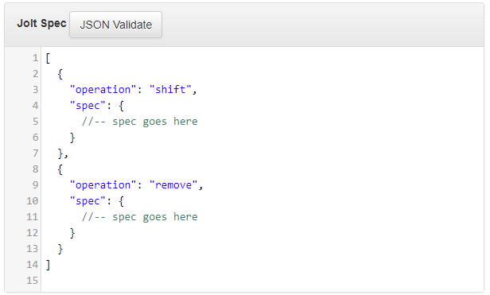
Jolt Spec Structure.

Slide 7
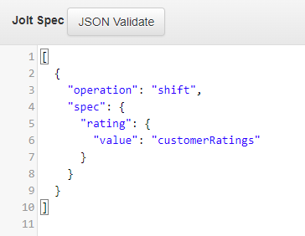
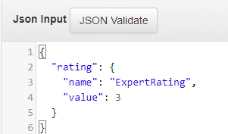
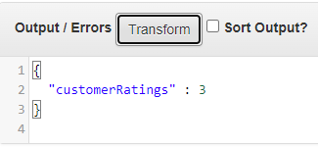
How to use JOLT? Example.

Slide 8
How to use JOLT? Example Explained.

Slide 9
How to use JOLT? Code Block
//-- Code to be added here

Slide 10
Spec Concept LHS:RHS
JSON content that is before : (colon) will be our LHS and what is after : (colon) will be our RHS.
LHS is structure to pic node to be transformed from input JSON
RHS is .(DOT) separated JSON path formatted structure.

Slide 11
Operations.
shift : pic value from one node drop in other node
default : if null in input, put default in output
remove : remove node from output
cardinality : convert one →array & array → one
modify-default-beta : modify if value is null or un-available.
modify-overwrite-beta : modify even if value is available

Slide 12
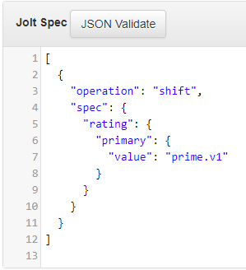
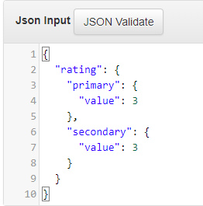
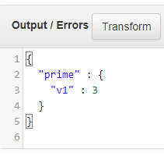
Shift : One to One

Slide 13
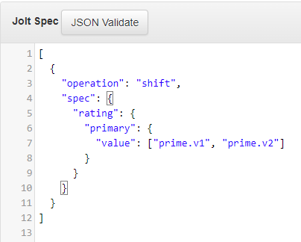
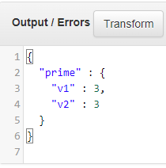
Shift : One to Many

Slide 14
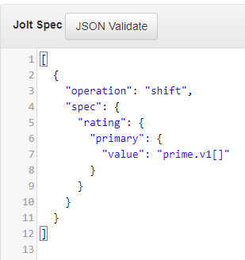
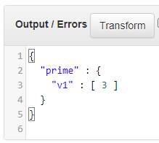
Shift: Put in array

Slide 15
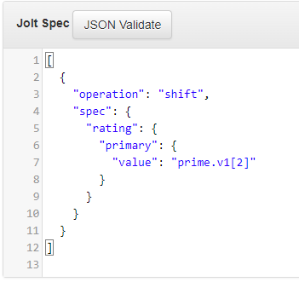
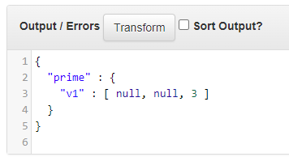
Shift: Put in array at specific index

Slide 16
Special Chars and its use.
Special Char | Used in | Operations | Use
& | RHS | Shift | Refer to current LHS node name &1 One level above current LHS node &(2) Two level above Current LHS …
* | LHS | shift, remove, cardinality, modify-default-beta & modify-overwrite-beta | Iterate Over items.
@ | LHS RHS | shift (LHS e RHS), modify-default-beta (RHS) modify-overwrite-beta (RHS). | Lookup Value in input json @ given node level.
$ | LHS | Shift | Only Field Names.
# | LHS RHS | Shift | Defines The way Object Array is created.
| | LHS | Shift | Input fields with uncertain name pointing to same output.

Slide 17
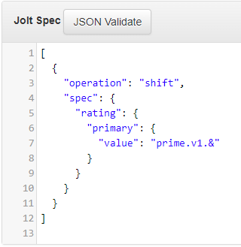
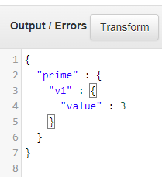
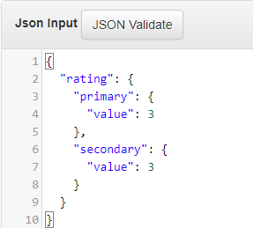
&

Slide 18
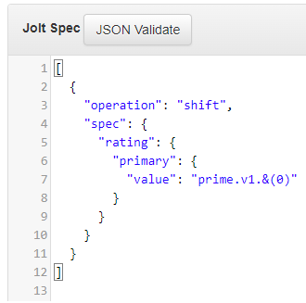
&

Slide 19
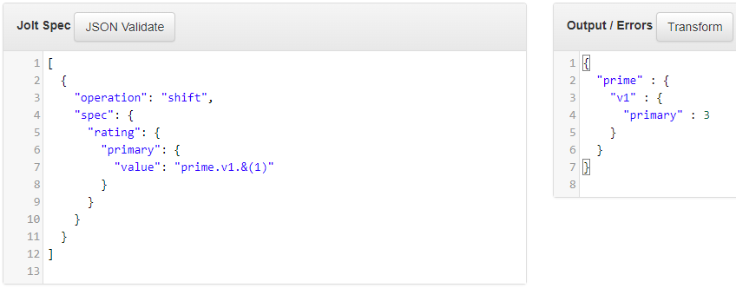
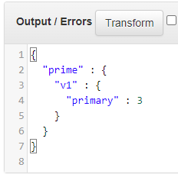
&(1)
Level 1
Level 0

Slide 20
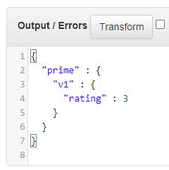
&(2)
Level 2
Level 1
Level 0

Slide 21
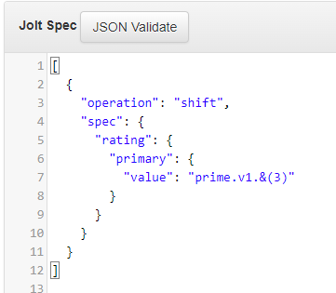
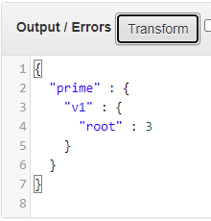
&(3)
Root
Level 2
Level 1
Level 0

Slide 22
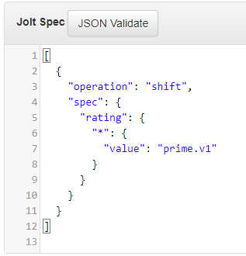
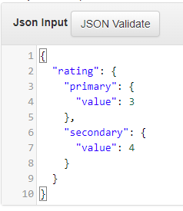
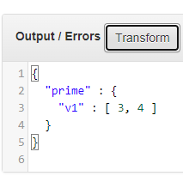
*
Refers to all elements

Slide 23
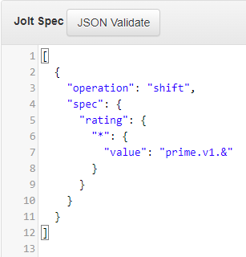
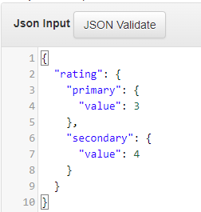
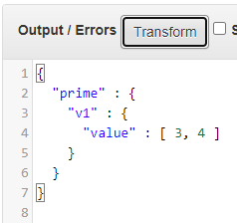
With &
*

Slide 24
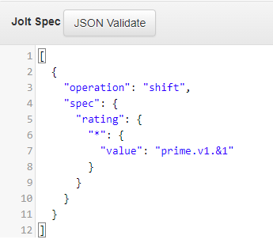
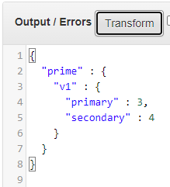
With &1
*
Level 1
Level 0

Slide 25
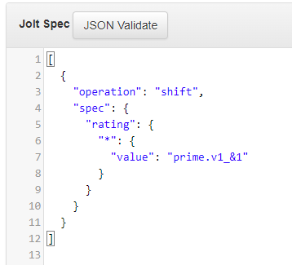
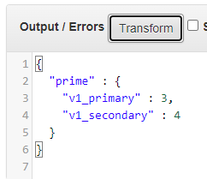
With &1 with prefix
*
Level 1

Slide 26
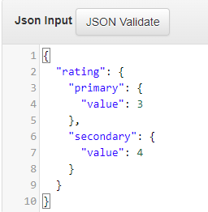
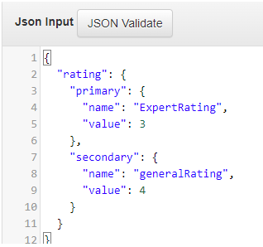
Consider changes in input
New field added “name”
Previous example’s input

Slide 27
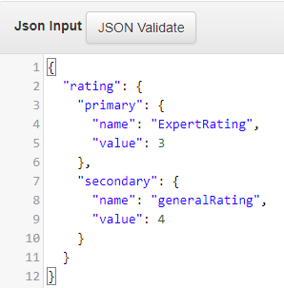
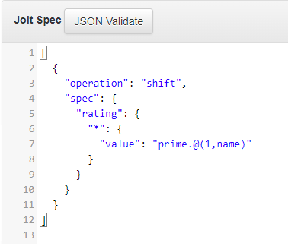
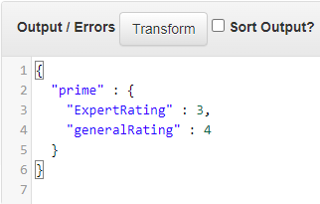
@
Level 1
Found node
Level 1
Level 0
Found node

Slide 28
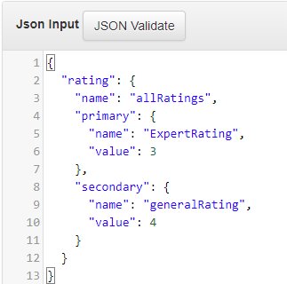
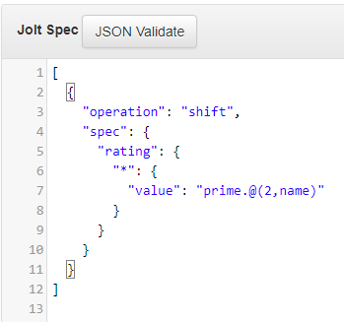
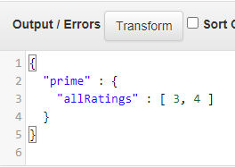
@ look for node On level and pic value.
Level 2
Found node
Level 1
Level 0
Lookup on level
Node to be lookup

Slide 29
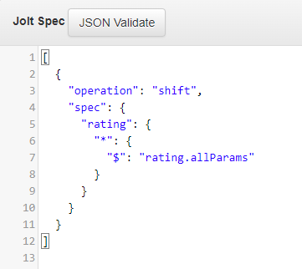
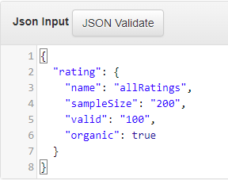
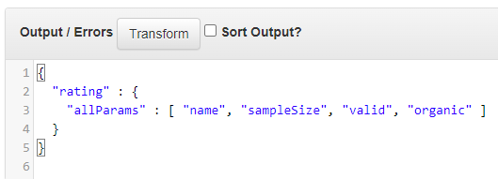
$ Refers to field’s names only
Loop all field
Names of field

Slide 30
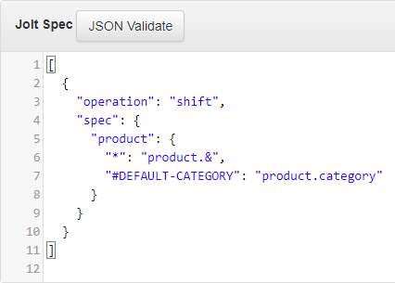
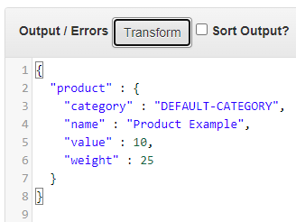
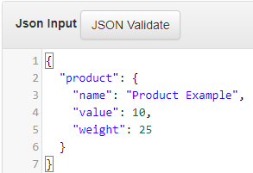
# in LHS – Default value.

Slide 31
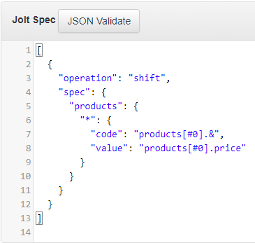
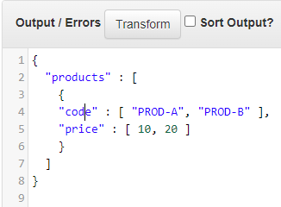
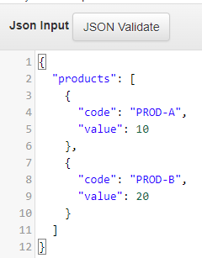
#0 in RHS – One Object & Every Field As Array
.

Slide 32
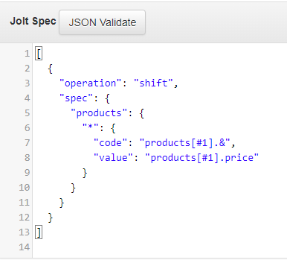

#1 in RHS – Array of Objects with Fields Array
.
.

Slide 33


#2 in RHS – Array of Objects of all Fields
.
.

Slide 34



#0
#1
#2
One Object for all fields
Object on Field basis
Object on each item iterated by *

Slide 35




|(pipe) when input field name is not confirmed.
OR

Slide 36



Remove: remove selected field
.
.
Only “”(blank) allowed,
null or any value is not allowed

Slide 37






Consider below case of two transform back2back
.
Transform 1
Transform 2

Slide 38

JOLT Operation chaining concept
Spec is an array
Array of Operations
Output of One Operation is input for Next operation.
.
Output of shift is passed as
Input to remove
.

Slide 39



Default : Replace null with default value

Slide 40



Default : Add If not present
.

Slide 41



Default : Blank is not null & it’s not replaced.
.
.

Slide 42



Cardinality : Type Conversion Object → Array

Slide 43



Cardinality : Type Conversion Array → Object
Discarded

Slide 44



SORT : Just sorting in alphabetical order

Slide 45

modify-overwrite-beta : type conversion

Slide 46



modify-overwrite-beta: SquashNulls
remove null but on same Level
Removed
Left over
Left over

Slide 47


modify-overwrite-beta: recursivelySquashNulls
look for all levels and remove null
Removed
Removed

Slide 48



modify-overwrite-beta: Add New Value
to each object in array
new
new

Slide 49



modify-overwrite-beta: Add New Value
to each object in array
.
.
.
Level 1 : Object in array
Level 2 : statistics
Level 3 : root
.

Slide 50



Simple IF Else
Anything else
Note: # means Fixed value

Slide 51



Add Prefix

Slide 52
More from https://jolt-demo.appspot.com/
Inception
Convert nested data, to 'prefix soup'.
Convert 'prefix soup', to nested data.
Grab LHS key values.
Map to list.
List to Map.
On a match, apply a String default.
Base case simple Transpose.
Complex / nested Transpose.
Escaping Shiftr special chars.
Transpose data in an Array.
Bucket data from an Array, based on a leaf level value.
Filter data from an Array, based on a leaf level value.

